Slide 1
SCRIP
Shop with gift cards in everyday categories including
groceries, gas, & restaurants.

Slide 2
Fundraising with Everyday Shopping
Troop receives anywhere from 1% - 16% per gift card purchased.
You can help the Troop with your everyday purchases
Includes
Grocery Stores (Acme, Shoprite, Weis, Giant, Whole Foods,
Gas (Shell, Sunoco, Exxon, Mobil, Wawa)
Department Stores (Walmart, Target, Macy’s, Nordstrom)
Entertainment and Travel (AMC, Regal, Disney)
OVER 750 VENDORS

Slide 3
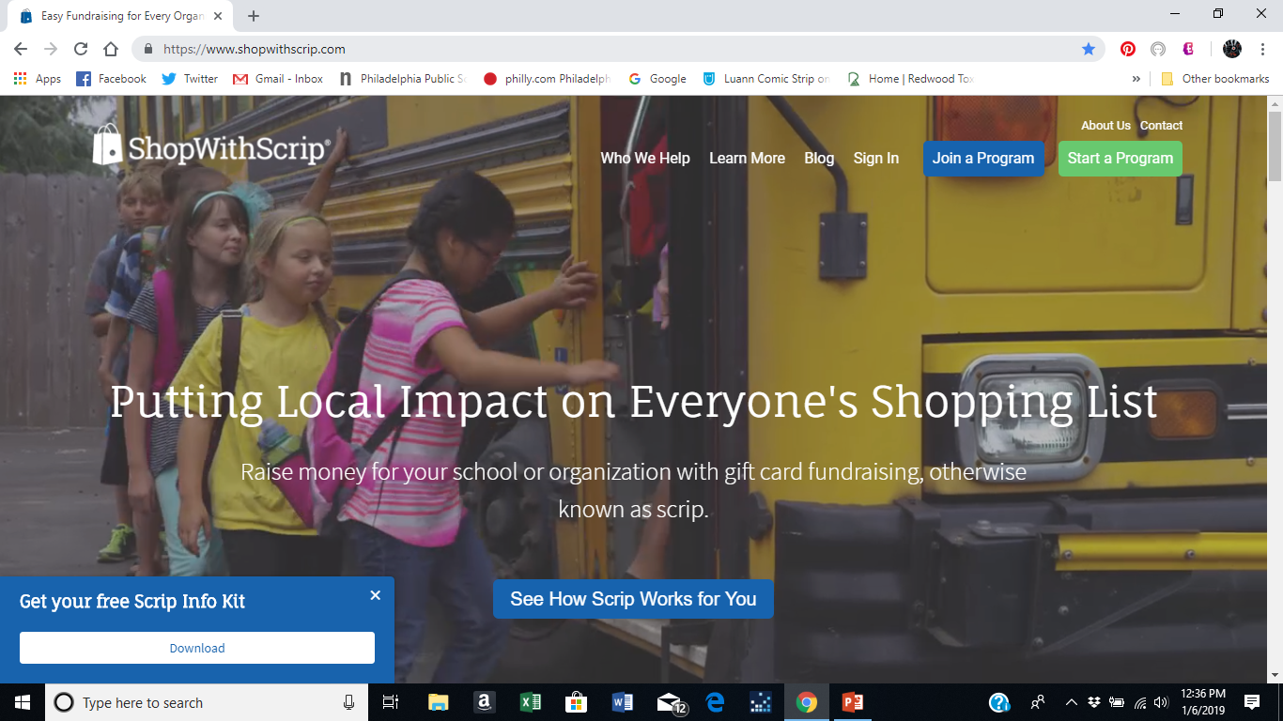
WEBSITE
www.shopwithscrip.com
Click on the join program

Slide 4
Enrollment Code B1DA45F2532LL

Slide 5
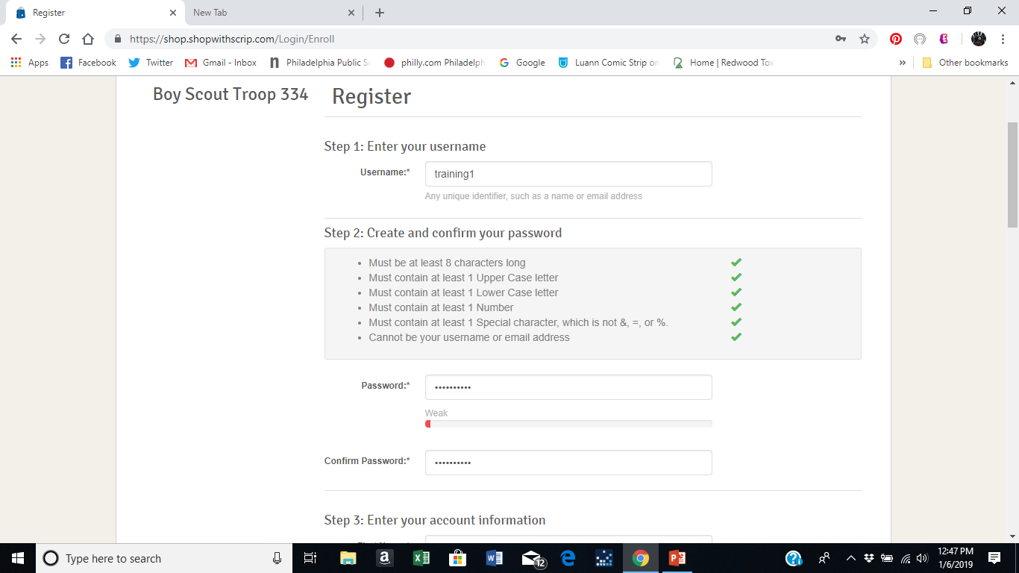
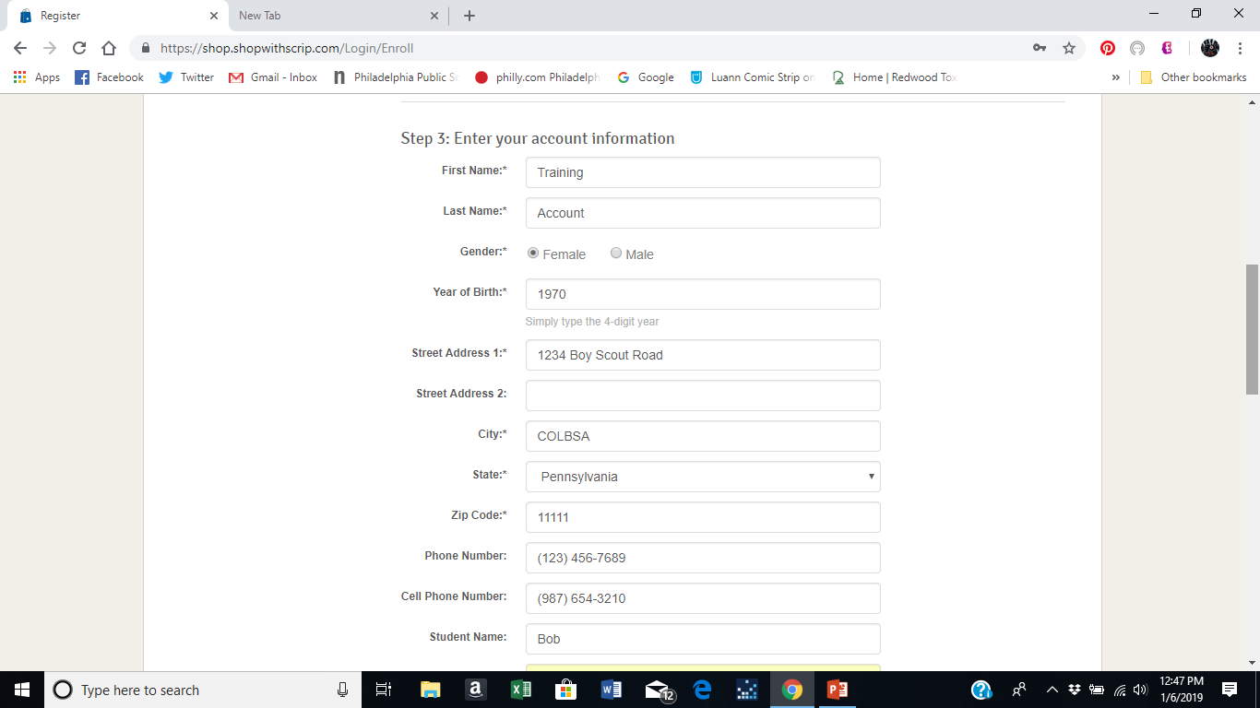
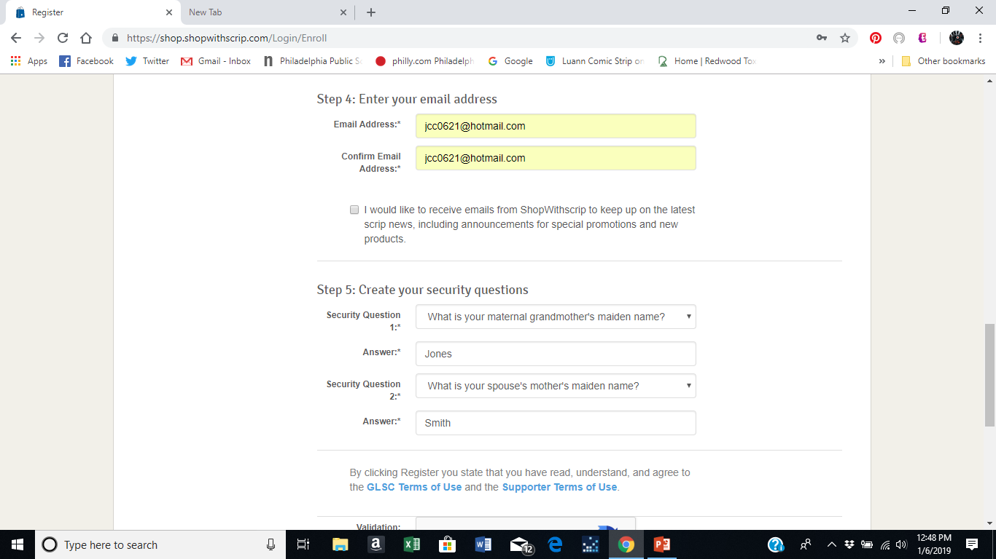
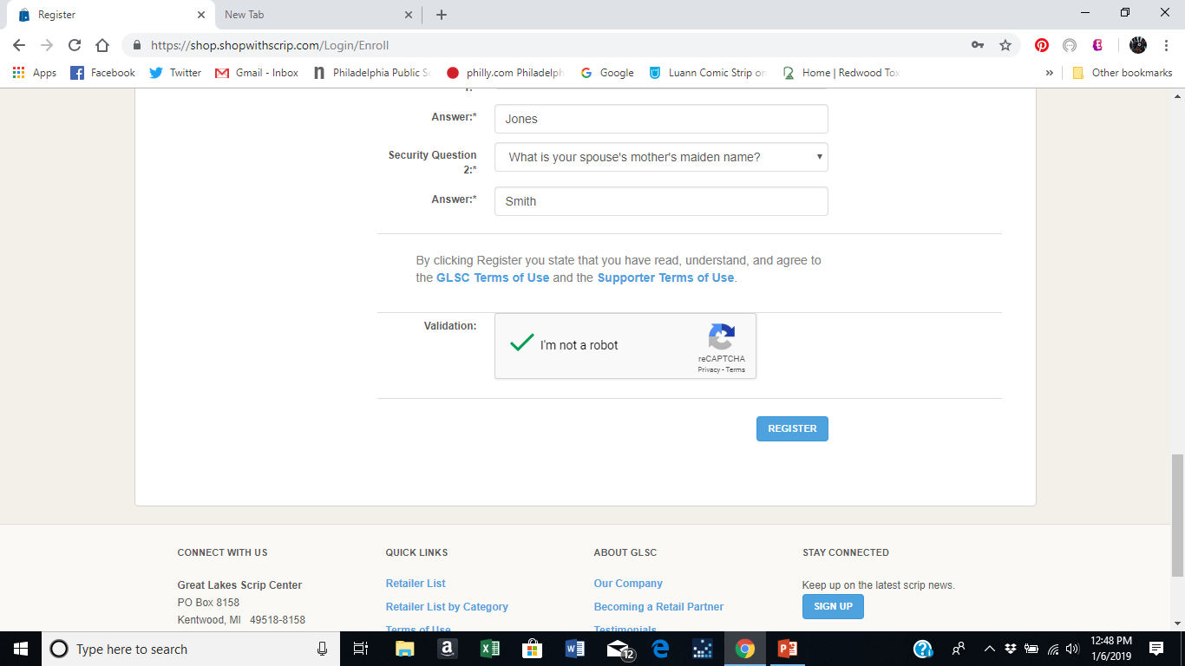
Complete Information and click register
You will then enter your cell or phone number to get a verification code to enter

Slide 6
PRESTO PAY

Slide 7
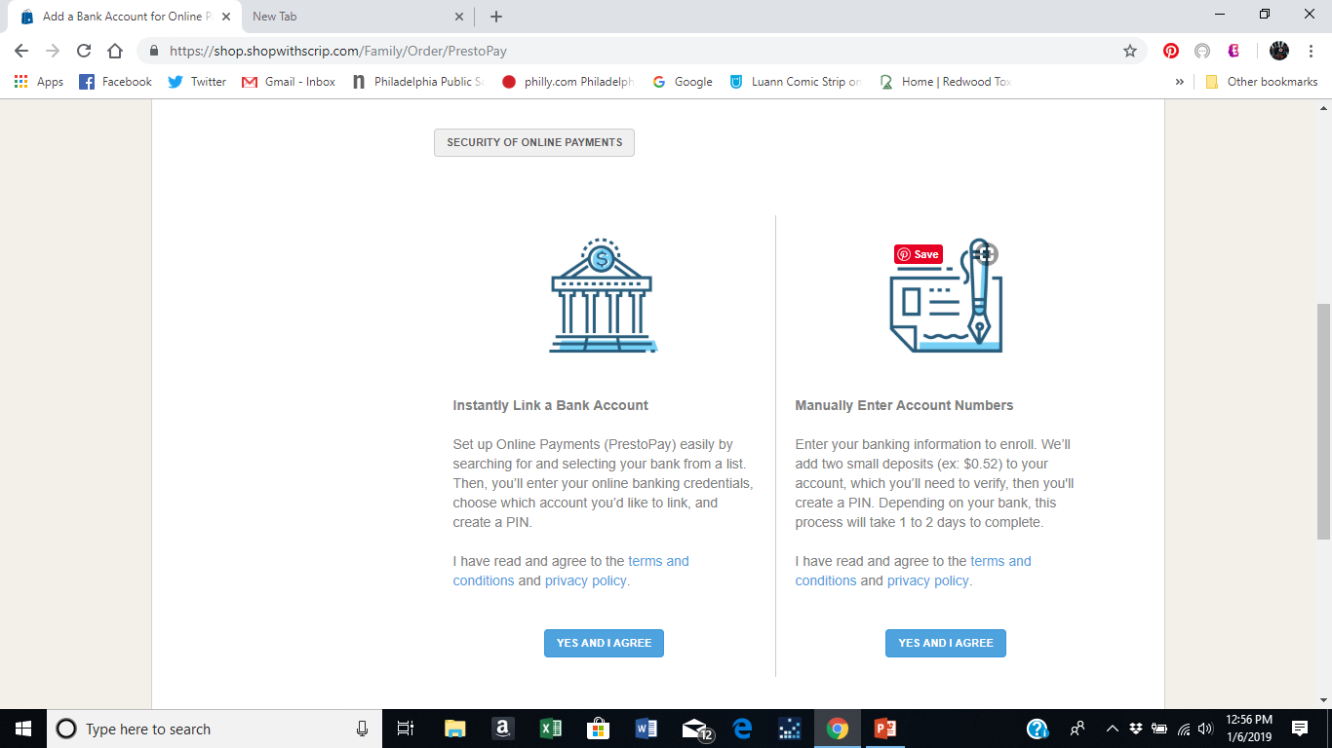
Paying Online

